Slide 1


Slide 2
Fundamentals of Ecology
Week 5, Ecology Lecture 2
Cara Brook
February 6, 2025

Slide 3
Learning objectives from Lecture 1
You should be able to:
Define ecology as a science
Distinguish a statistical model (pattern) from a population model (process)
Construct a simple box plot for a population model
Distinguish geometric and exponential growth – and know when to apply which model to which kinds of data
Understand what it means to ‘fit’ a model to data
Interpret whether growth is slowing, accelerating, or constant from lines ‘fit’ to different time points

Slide 4
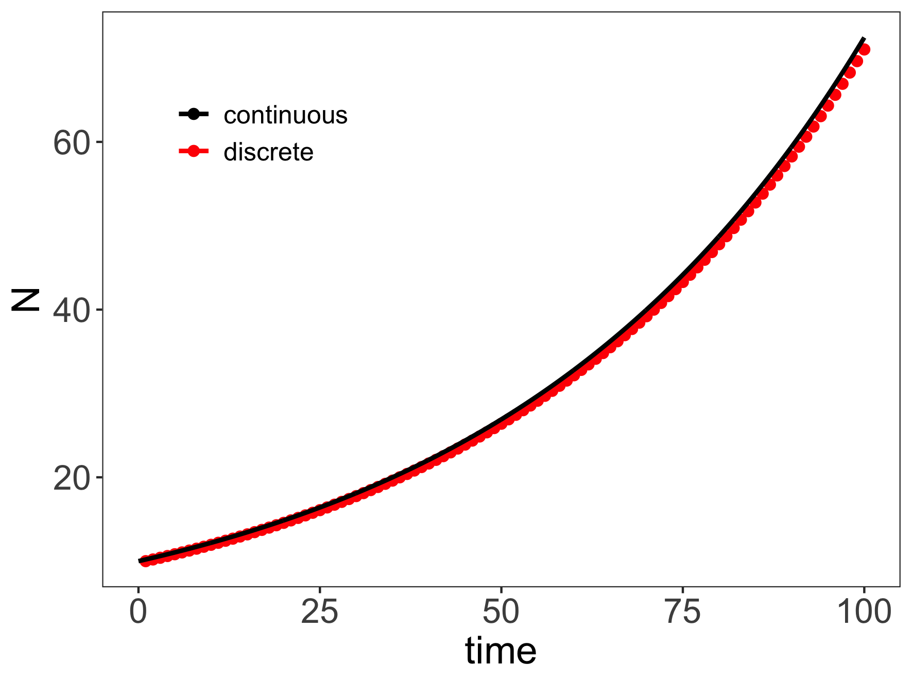
Both geometric and exponential growth are unchecked.

Slide 5
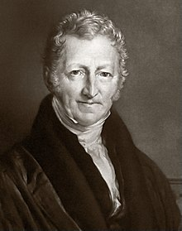
Malthus proposed some limits to population growth
“[. . . ] the power of population is indefinitely greater than the power in the earth to produce subsistence for man. Population, when unchecked, increases in a geometrical ratio. Subsistence increases only in an arithmetical ratio. A slight acquaintance with numbers will shew the immensity of the first power in comparison of the second. By that law of our nature which makes food necessary to the life of man, the effects of these two unequal powers must be kept equal. This implies a strong and constantly operating check on population from the difficulty of subsistence. This difficulty must fall somewhere; and must necessarily be severely felt by a large portion of mankind.”
- Thomas Malthus (1798)
An Essay on the Principle of Population as it Effects the Future Improvement of Society,
With Remarks on the Speculations of Mr Godwin, Mr. Condorcet and Other Writers
Notes:
Thomas Malthus. English cleric in the late 1700s, early 1800s.
Published the book anonymously.

Slide 6
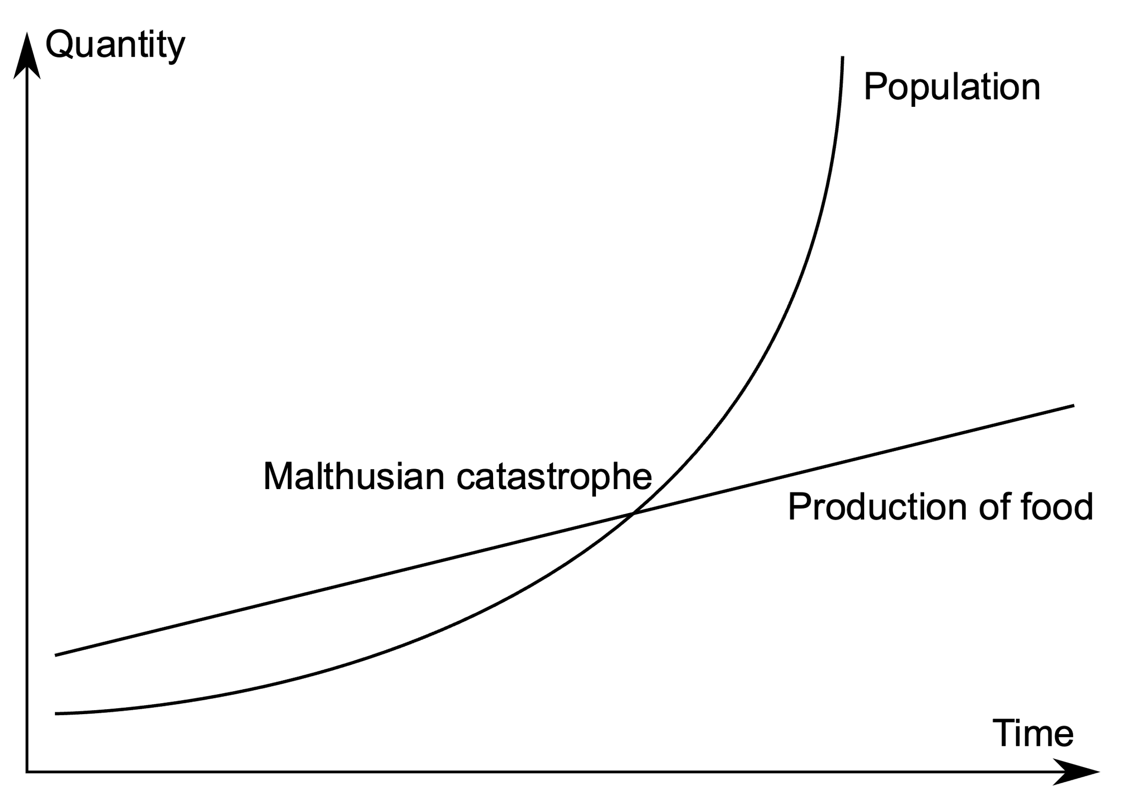
Malthus proposed some limits to population growth
- Thomas Malthus (1798)
An Essay on the Principle of Population as it Effects the Future Improvement of Society,
With Remarks on the Speculations of Mr. Godwin, Mr. Condorcet and Other Writers
Notes:
Thomas Malthus. English cleric in the late 1700s, early 1800s.
Inspired strong reactions. Darwin was inspired. Marx was disgusted
Marx claimed that poverty and hunger was a result of the capitalist economy, not population growth. He argued that food supplies would keep pace with population growth if wealth was distributed fairly
Malthus offered no basis for his arithmetical ratio for food, and there were occasions in which food had increased geometrically to match a geometric rise in population (as in North America)
Indeed, the industrial revolution proved that human food production could keep pace with population growth

Slide 7
Malthus proposed some limits to population growth
Problem!
No basis for assumption of arithmetical ratio for food.
- Thomas Malthus (1798)
An Essay on the Principle of Population as it Effects the Future Improvement of Society,
With Remarks on the Speculations of Mr. Godwin, Mr. Condorcet and Other Writers
Notes:
Thomas Malthus. English cleric in the late 1700s, early 1800s.
Inspired strong reactions. Darwin was inspired. Marx was disgusted
Marx claimed that poverty and hunger was a result of the capitalist economy, not population growth. He argued that food supplies would keep pace with population growth if wealth was distributed fairly
Malthus offered no basis for his arithmetical ratio for food, and there were occasions in which food had increased geometrically to match a geometric rise in population (as in North America)
Indeed, the industrial revolution proved that human food production could keep pace with population growth
Led him to write a second essay that proposed all kinds of ways to keep population in check: famine, war, abortion, delayed marriage. Very anti-charity
An Essay on the Principle of Population, or a View of its Past and Present Effects
on Human Happiness, With an Enquiry Into Our Prospects Respecting the Future Removal or Mitigation of the Evils Which It Occasions

Slide 8
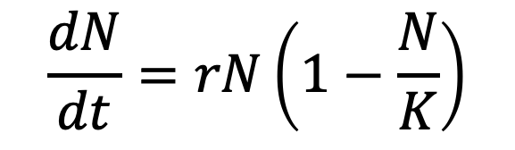
Logistic growth equation
“We shall not insist on the hypothesis of geometric progression, given that it can hold only in very special
circumstances; for example, when a fertile territory of almost unlimited size happens to be inhabited by people…”
- Pierre-Francois Verhulst (1838)
$$\frac{dN}{dt}=rN\left(1−\frac{N}{K}\right)$$
Notes:
Verlhust = Belgian mathematician in the 1800s

Slide 9
Logistic growth equation
“We shall not insist on the hypothesis of geometric progression, given that it can hold only in very special
circumstances; for example, when a fertile territory of almost unlimited size happens to be inhabited by people…”
- Pierre-Francois Verhulst (1838)
change in population abundance per unit time
$$\frac{dN}{dt}=rN\left(1−\frac{N}{K}\right)$$
population size
intrinsic growth rate
carrying capacity

Slide 10
Logistic growth equation
“We shall not insist on the hypothesis of geometric progression, given that it can hold only in very special
circumstances; for example, when a fertile territory of almost unlimited size happens to be inhabited by people…”
- Pierre-Francois Verhulst (1838)
change in population abundance per unit time
$$\frac{dN}{dt}=rN\left(1−\frac{N}{K}\right)$$
population size
intrinsic growth rate
carrying capacity
Population growth slows as abundance (N) approaches carrying capacity (K).
Population growth is density-dependent.

Slide 11
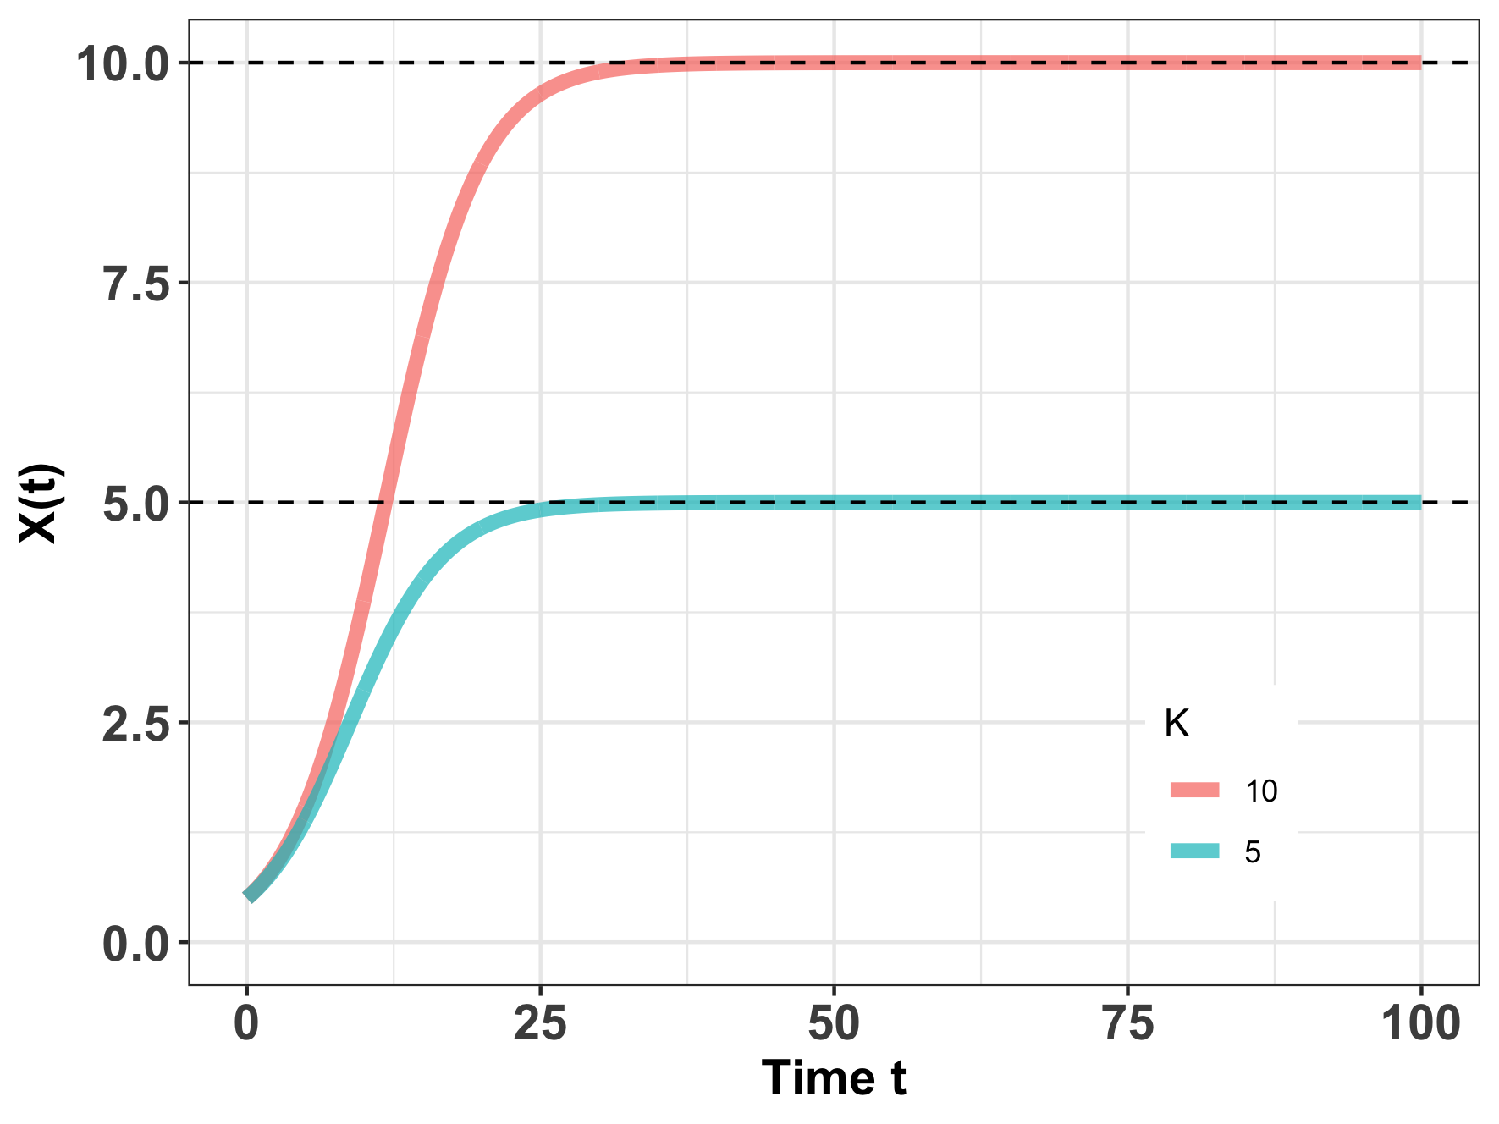
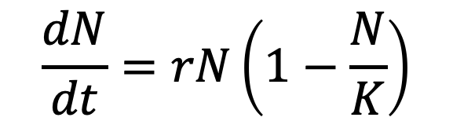
Logistic growth equation
$$\frac{dN}{dt}=rN\left(1−\frac{N}{K}\right)$$
Population growth slows to 0 as N approaches K, or – in other words – as the total population size approaches carrying capacity.
N(t)
Notes:
Ecology – interaction of organisms with each other (population) and their environment (sets K)
R vs. K selected species

Slide 12
Logistic growth equation
$$\frac{dN}{dt}=rN\left(1−\frac{N}{K}\right)$$
Carrying capacity=
maximum population size an environment can sustain indefinitely.
N(t)
Notes:
Ecology – interaction of organisms with each other (population) and their environment (sets K)
Food, shelter, water
Can CHANGE!

Slide 13
Logistic growth equation
$$\frac{dN}{dt}=rN\left(1−\frac{N}{K}\right)$$
Carrying capacity=
maximum population size an environment can sustain indefinitely.
Ecology = organisms interacting with each other and the environment
N(t)
Notes:
Ecology – interaction of organisms with each other (population) and their environment (sets K)
Food, shelter, water
Can CHANGE!

Slide 14
Logistic growth equation
$$\frac{dN}{dt}=rN\left(1−\frac{N}{K}\right)$$
Carrying capacity=
maximum population size an environment can sustain indefinitely.
Ecology = organisms interacting with each other and the environment
K can change!
N(t)
Notes:
Ecology – interaction of organisms with each other (population) and their environment (sets K)
Food, shelter, water
Can CHANGE!

Slide 15
Logistic growth equation
$$\frac{dN}{dt}=rN\left(1−\frac{N}{K}\right)$$
Carrying capacity=
maximum population size an environment can sustain indefinitely.
Ecology = organisms interacting with each other and the environment
K can change!
‘r’ vs. ‘K’-selected species
N(t)
Notes:
Ecology – interaction of organisms with each other (population) and their environment (sets K)
Food, shelter, water
Can CHANGE!

Slide 16
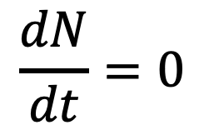
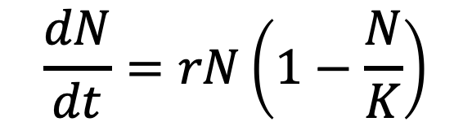
Logistic growth and equilibrium
$$\frac{dN}{dt}=rN\left(1−\frac{N}{K}\right)$$
$$\frac{dN}{dt}=0$$
When population size is not changing, the population is said to be at equilibrium.
N(t)

Slide 17
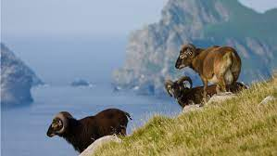
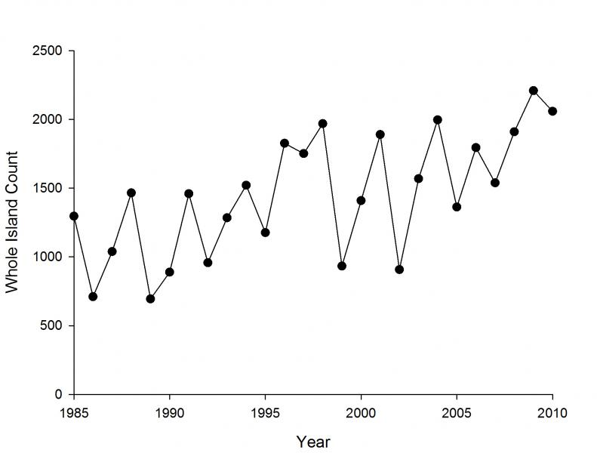
Many populations will fluctuate above or below carrying capacity.
Soay Sheep of St. Kilda, Scotland

Slide 18
Many populations will fluctuate above or below carrying capacity.
But they can still be stable populations if they return to equilibrium.
Soay Sheep of St. Kilda, Scotland
Notes:
We’ll talk about what happens when you

Slide 19

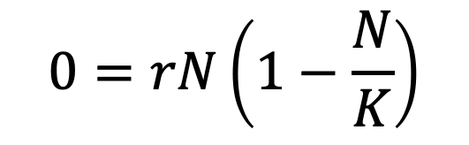
Logistic growth and equilibrium
$$\frac{dN}{dt}=rN\left(1−\frac{N}{K}\right)$$
$$\frac{dN}{dt}=0$$
$$0=rN\left(1−\frac{N}{K}\right)$$
N(t)
$$N=K$$
A little algebra shows that the population at carrying capacity is at equilibrium.

Slide 20
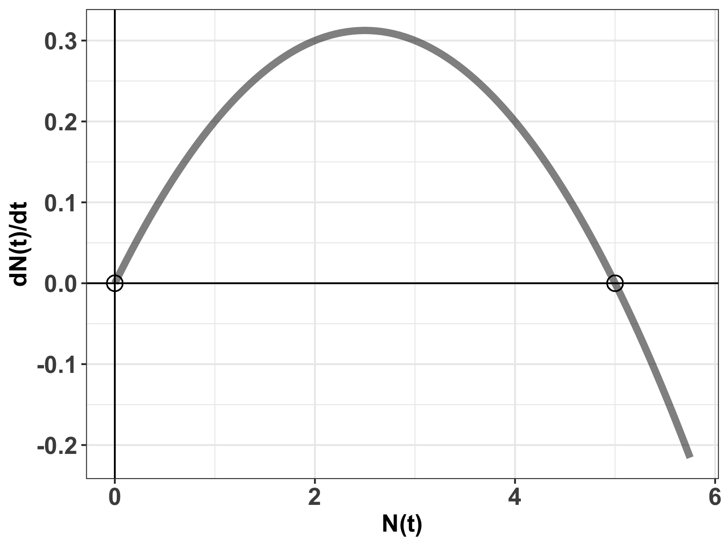


Logistic growth and equilibrium
$$\frac{dN}{dt}=rN\left(1−\frac{N}{K}\right)$$
$$\frac{dN}{dt}=0$$
$$0=rN\left(1−\frac{N}{K}\right)$$
$$N=K or$$
logistic growth equilibria
$$N=0$$

Slide 21
Logistic growth and equilibrium
$$\frac{dN}{dt}=rN\left(1−\frac{N}{K}\right)$$
$$\frac{dN}{dt}=0$$
$$0=rN\left(1−\frac{N}{K}\right)$$
$$N=K or$$
logistic growth equilibria
$$N=0$$
What is K?

Slide 22

Logistic growth and equilibrium
$$\frac{dN}{dt}=rN\left(1−\frac{N}{K}\right)$$
$$\frac{dN}{dt}=0$$
$$K=5$$
$$0=rN\left(1−\frac{N}{K}\right)$$
$$N=K or$$
logistic growth equilibria
$$N=0$$
What is K?

Slide 23

Logistic growth and equilibrium
$$\frac{dN}{dt}=rN\left(1−\frac{N}{K}\right)$$
$$\frac{dN}{dt}=0$$
$$K=5$$
$$0=rN\left(1−\frac{N}{K}\right)$$
$$N=K or$$
logistic growth equilibria
$$N=0$$
Stability: If the population is perturbed, will it return to equilibrium?

Slide 24
Logistic growth and equilibrium
$$\frac{dN}{dt}=rN\left(1−\frac{N}{K}\right)$$
$$\frac{dN}{dt}=0$$
$$K=5$$
When population size is not changing, the population is said to be at equilibrium.
Mathematically, the carrying capacity (K) can be shown to be a stable equilibrium, meaning that if the system is perturbed, growth will accelerate or decelerate to return the population to K.
Notes:
N= K is a stable equilibrium. Small negative perturbations to the system will result in r > 0 which will grow to N=K. Small negative perturbations to the system will result in r <0 and sink to N=K
N= 0 is an unstable equilibrium. Small perturbations to the system around N=0 will result in r > 0 which will grow to N = K.

Slide 25
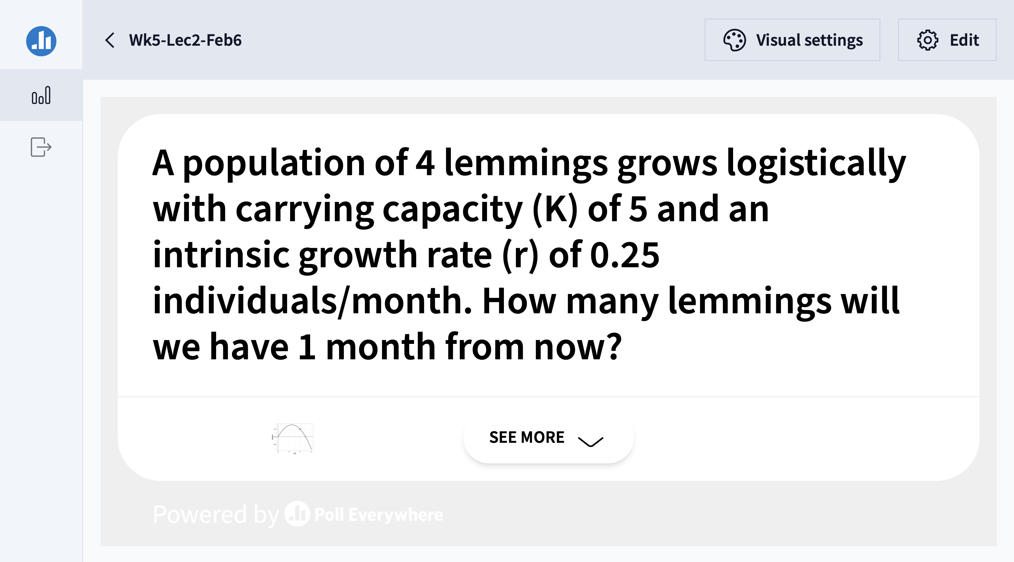

Slide 26
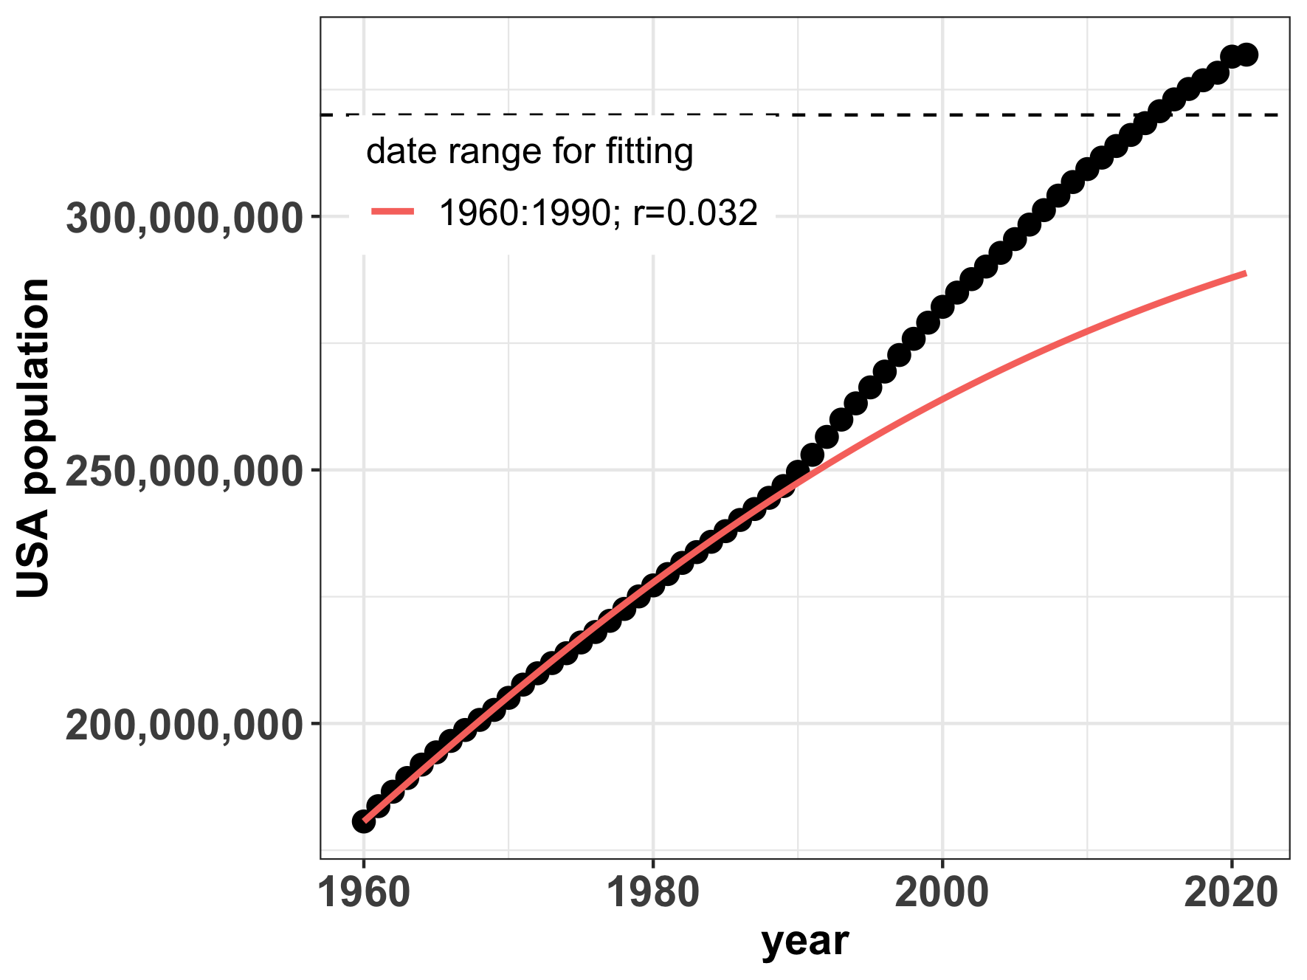
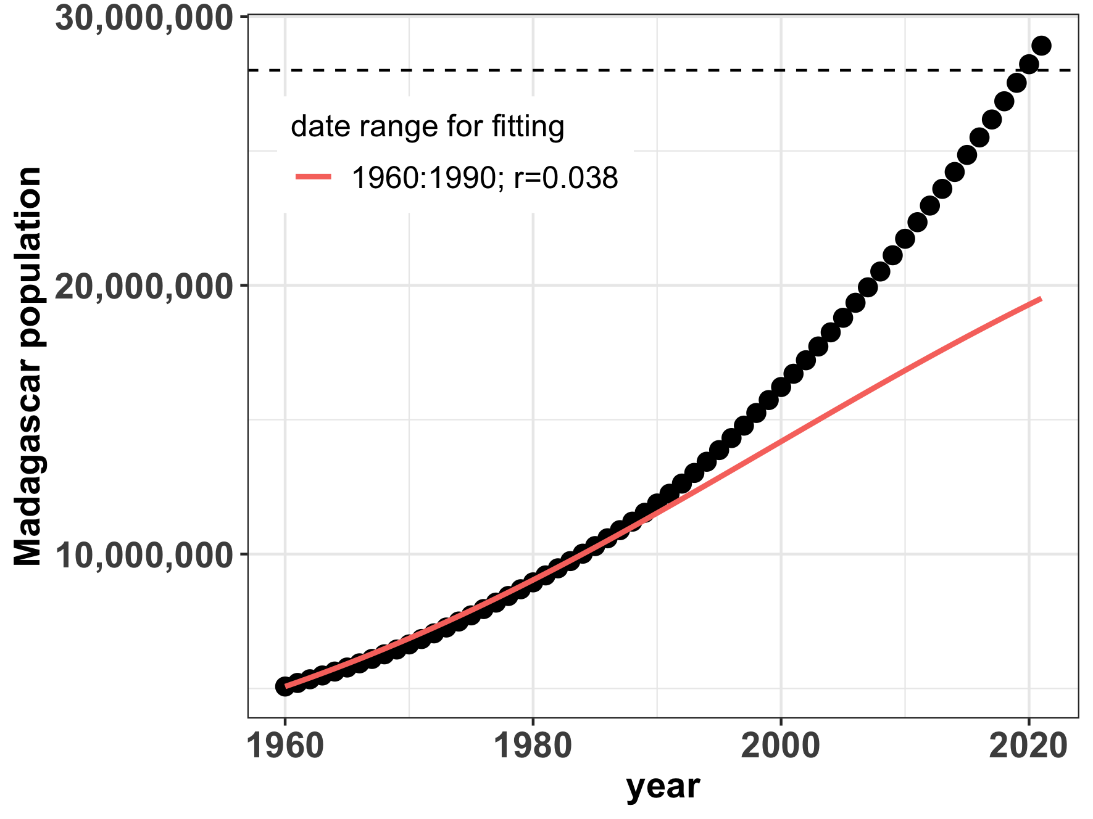
Despite Malthus’ predictions, logistic growth still does not describe human populations well.
K=302,000,000
K=28,000,000
Notes:
We are exceeding carrying capacity as might have been projected in 1990… Maybe the US is starting to move towards an S curve but Madagascar definitely not
The question is whether we overshoot our own K, as Malthus predicted - or not!

Slide 27
Logistic growth and harvesting
Humans have attempted to leverage density-dependent growth rates for sustainable harvesting, which refers to the offtake of individuals within a population’s capacity for replenishment. Frequently, this refers to the harvesting of animals for human consumption.
Notes:
Now that we understand density-dependent growth, we’ll explore how humans have attempted to leverage this stability

Slide 28
Logistic growth and harvesting
Humans have attempted to leverage density-dependent growth rates for sustainable harvesting, which refers to the offtake of individuals within a population’s capacity for replenishment. Frequently, this refers to the harvesting of animals for human consumption.
The science of sustainable harvest is used extensively in fisheries management.
Notes:
Now that we understand density-dependent growth, we’ll explore how humans have attempted to leverage this stability

Slide 29
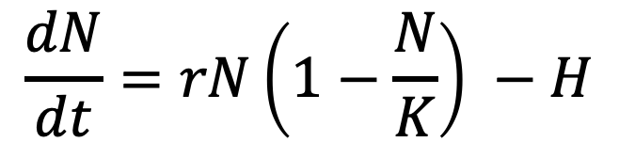
Logistic growth and harvesting
Humans have attempted to leverage density-dependent growth rates for sustainable harvesting, which refers to the offtake of individuals within a population’s capacity for replenishment. Frequently, this refers to the harvesting of animals for human consumption.
The science of sustainable harvest is used extensively in fisheries management.
population size
change in population size with time
$$\frac{dN}{dt}=rN\left(1−\frac{N}{K}\right) −H$$
harvesting rate
carrying capacity
intrinsic growth rate
density-dependence
Notes:
Now that we understand density-dependent growth, we’ll explore how humans have attempted to leverage this stability

Slide 30
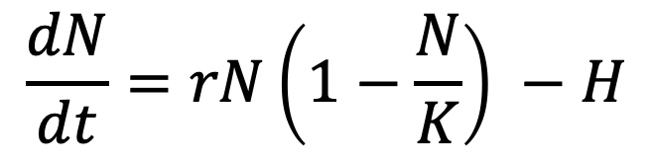
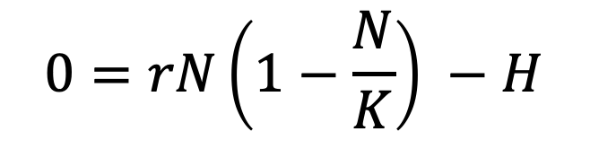
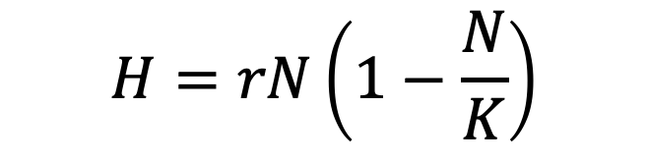
Logistic growth and harvesting
$$\frac{dN}{dt}=rN\left(1−\frac{N}{K}\right) −H$$
$$0=rN\left(1−\frac{N}{K}\right) −H$$
For a harvested population, theoretically, the population size is at equilibrium if the harvest rate equals the population change.
$$H=rN\left(1−\frac{N}{K}\right)$$

Slide 31
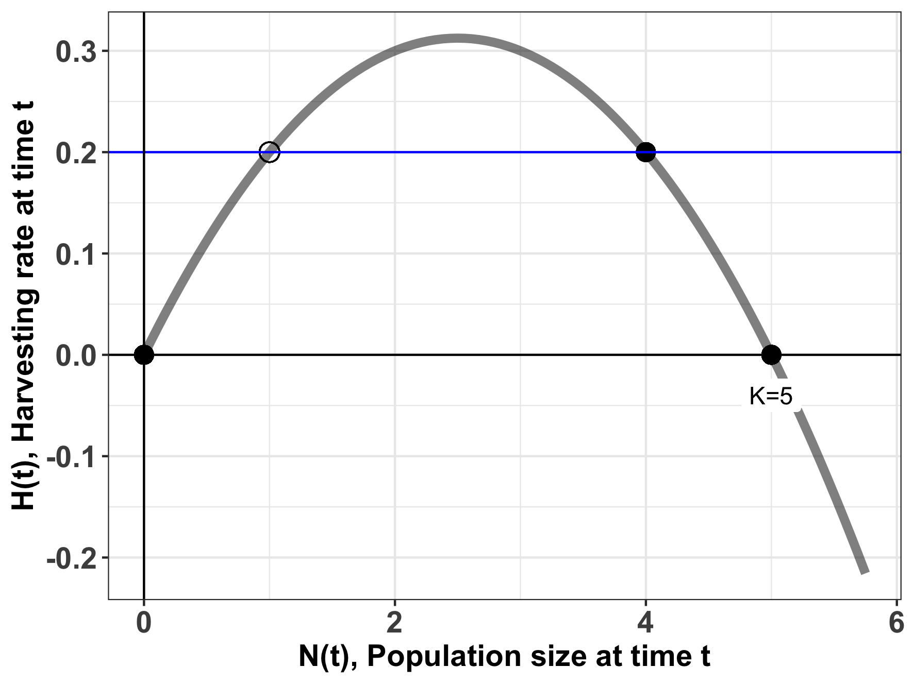
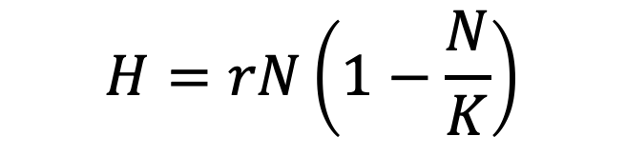
The stability of harvesting depends on population size.
$$H=rN\left(1−\frac{N}{K}\right)$$
harvesting rate
carrying capacity
Curve shows equilibrium solutions to harvesting equation, with r= 0.25 & K=5.
Some equilibria are stable, and some are unstable.

Slide 32
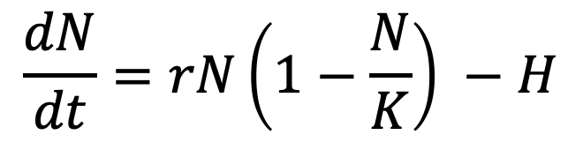
The stability of harvesting depends on population size.
$$\frac{dN}{dt}=rN\left(1−\frac{N}{K}\right) −H$$
stable equilibrium
For a population of N=4, a harvest rate of 0.2 (animals/timestep) results in a stable equilibrium (sustainable harvest).
Notes:
N=4 is a stable equilibrium. Small negative perturbations to the system will result in r > 0 which will grow to N=4. Small negative perturbations to the system will result in r <0 and sink to N=4.
You can test this just by filling in values. This curve was built assuming r = 0.25 and K= 5. Try it testing N=2 (dN/dt eqn is positive) or N=6 (dN/dt eqn is negative)

Slide 33
The stability of harvesting depends on population size.
$$\frac{dN}{dt}=rN\left(1−\frac{N}{K}\right) −H$$
stable equilibrium
For a population of N=4, a harvest rate of 0.2 (animals/timestep) results in a stable equilibrium (sustainable harvest).
Increases or decreases in population size will be compensated to return the system to N=4.
Notes:
You can test this just by filling in values. This curve was built assuming r = 0.25 and K= 5. Try it testing N=2 (dN/dt eqn is positive) or N=6 (dN/dt eqn is negative)

Slide 34
The stability of harvesting depends on population size.
$$\frac{dN}{dt}=rN\left(1−\frac{N}{K}\right) −H$$
unstable equilibrium
For a population of N=1, a harvest rate of 0.2 (animals/timestep) results in an unsustainable equilibrium.
Notes:
N= 1 is an unstable equilibrium.
Small negative perturbations to the system around N=2 will sink to N=0.
Small positive perturbations to the system around N=2 will will grow to N=4.
You can test this just by filling in values. This curve was built assuming r = 0.25 and K= 5. Try it testing N=2 (dN/dt eqn is positive) or N=.5 (dN/dt eqn is negative)

Slide 35
The stability of harvesting depends on population size.
$$\frac{dN}{dt}=rN\left(1−\frac{N}{K}\right) −H$$
unstable equilibrium
For a population of N=1, a harvest rate of 0.2 (animals/timestep) results in an unsustainable equilibrium.
Random increases or decreases in population size will result in the population moving away from N=1 to, respectively, N=4 or N=0 (the latter is a population collapse).
Notes:
𝐌2−4𝐇𝐌𝐤 > 0 ⇒ 𝐇<𝐤𝐌4 − �2−4��� > 0 ⇒ �<��4 − ("subcritical harvesting"): we have two equilibrium solutions smaller than 𝑀 � , the "carrying capacity" in the standard logistic model, that we could call 𝑀+ �+ and 𝑀− �− ; the differential equation becomes 𝑑𝑃𝑑𝑡 = −𝑘𝑀·(𝑃−𝑀+)·(𝑃−𝑀−) ,���� = −��·(�−�+)·(�−�−) , which is separable and can be solved by using partial-fraction decomposition; we in turn have three cases for the initial condition, 𝑃0<𝑀− , 𝑀−<𝑃0<𝑀+ , �0<�− , �−<�0<�+ , and 𝑃0>𝑀+ ; �0>�+ ; we find that 𝑀+ �+ is the "attractor" (stable) equilibrium solution and 𝑀− �− is the "repeller" (unstable) equilibrium
N= 1 is an unstable equilibrium.
Small negative perturbations to the system around N=2 will sink to N=0.
Small positive perturbations to the system around N=2 will will grow to N=4.
You can test this just by filling in values. This curve was built assuming r = 0.25 and K= 5. Try it testing N=2 (dN/dt eqn is positive) or N=.5 (dN/dt eqn is negative)

Slide 36
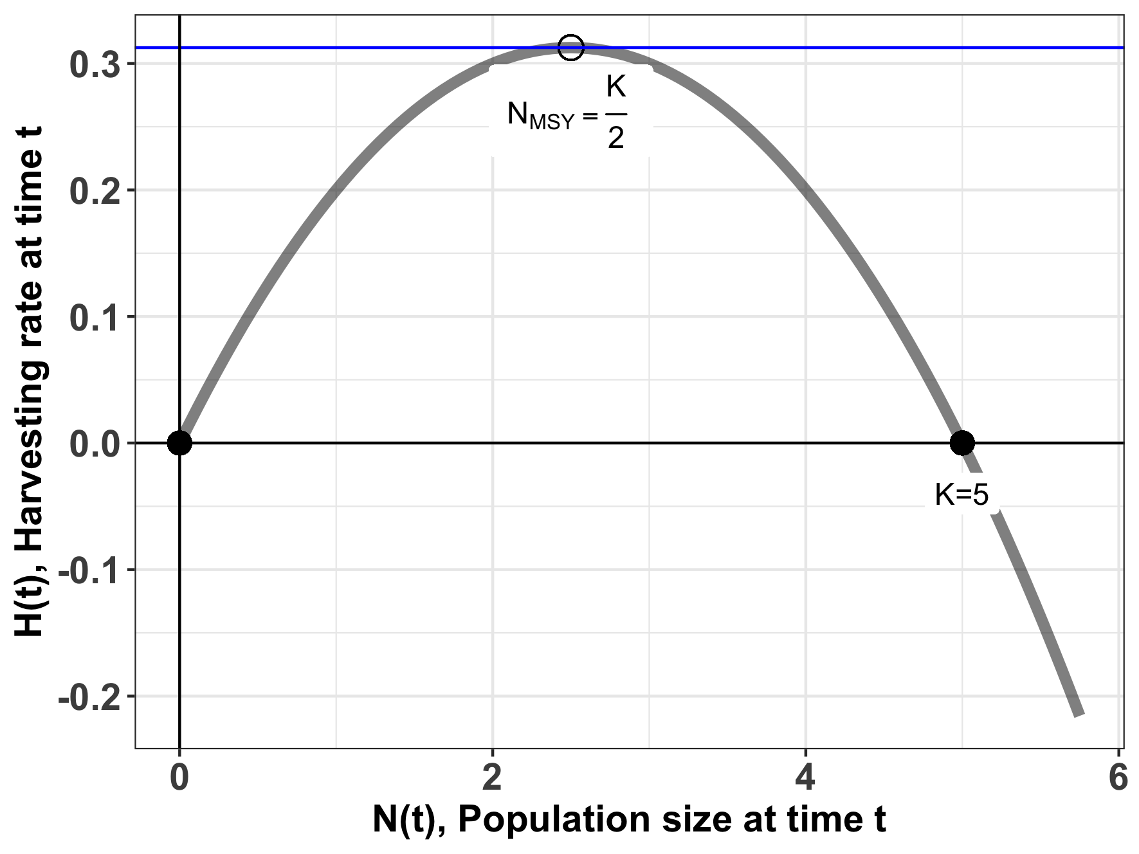
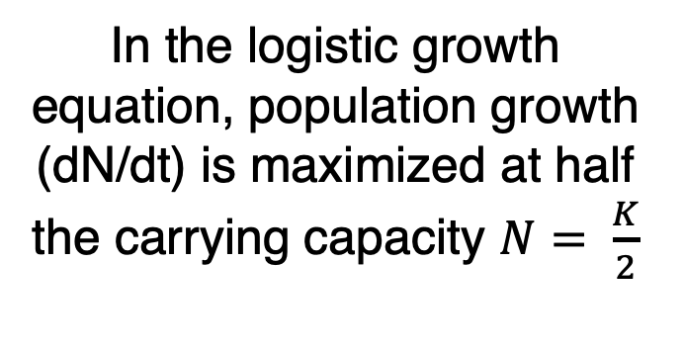
Maximum sustainable yield (MSY)
$$H=rN\left(1−\frac{N}{K}\right)$$
In the logistic growth equation, population growth (dN/dt) is maximized at half the carrying capacity $N= \frac{K}{2}$
Notes:
You can test this by filling in values of N on either side of N=2.5 (try N=3 and N=2) for harvesting = 0.25*5/4 = 0.312

Slide 37
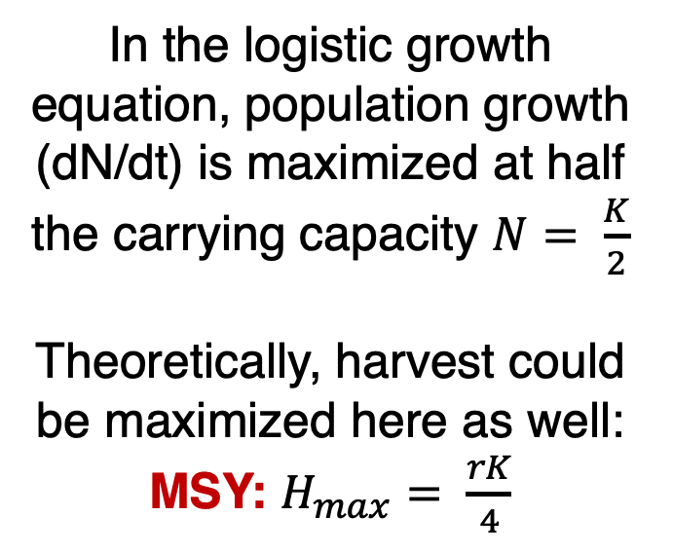
Maximum sustainable yield (MSY)
$$H=rN\left(1−\frac{N}{K}\right)$$
In the logistic growth equation, population growth (dN/dt) is maximized at half the carrying capacity $N= \frac{K}{2}$
Theoretically, harvest could be maximized here as well:
MSY: $H_{max}= \frac{rK}{4}$
take the derivative with respect to N

Slide 38

Maximum sustainable yield (MSY)
$$H=rN\left(1−\frac{N}{K}\right)$$
MSY: $H_{max}= \frac{rK}{4}$
The MSY is a semi-stable equilibrium, meaning that small gains in population size (N) will be compensated to return the system to N_{MSY,} while small losses will result in the system collapsing to N=0.

Slide 39


Slide 40
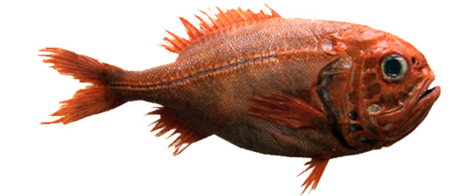
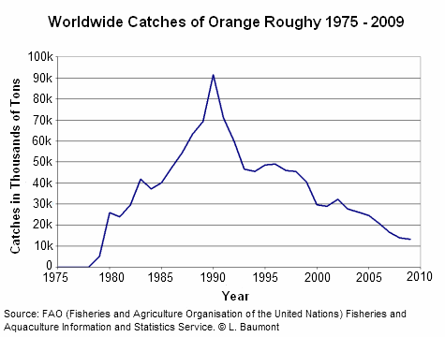
Case Study: Orange Roughy
Many populations will fluctuate above or below carrying capacity.
But they can still be stable populations if they return to equilibrium.
In some cases, it is not possible to recover.
Notes:
Orange roughy = overexploited fishery in mostly southern hemisphere. Large, very long-lived fish. Biggest fishery in NZ but also important in Australia

Slide 41
Case Study: Orange Roughy
Found in deep waters of eastern Pacific (Chile), western Pacific (Australia/NZ), and southeastern Atlantic (Namibia to South Africa)
Can live up to 200 years! Matures at 20-30 yrs
Fished via trawling, originally thought to have only a 30-year lifespan
Annual global catches began in 1979 and increased to over 90,000 tons in the late 1980s.
High catch levels quickly decreased as stocks were fished down. By the late 1990s, three of the eight NZ orange roughy fisheries had collapsed and were closed.

Slide 42
Case Study: Orange Roughy
Found in deep waters of eastern Pacific (Chile), western Pacific (Australia/NZ), and southeastern Atlantic (Namibia to South Africa)
Can live up to 200 years! Matures at 20-30 yrs
Fished via trawling, originally thought to have only a 30-year lifespan
Annual global catches began in 1979 and increased to over 90,000 tons in the late 1980s.
High catch levels quickly decreased as stocks were fished down. By the late 1990s, three of the eight NZ orange roughy fisheries had collapsed and were closed.

Slide 43
Case Study: Orange Roughy
Found in deep waters of eastern Pacific (Chile), western Pacific (Australia/NZ), and southeastern Atlantic (Namibia to South Africa)
Can live up to 200 years! Matures at 20-30 yrs
Fished via trawling, originally thought to have only a 30-year lifespan
Annual global catches began in 1979 and increased to over 90,000 tons in the late 1980s.
High catch levels quickly decreased as stocks were fished down. By the late 1990s, three of the eight NZ orange roughy fisheries had collapsed and were closed.

Slide 44
Case Study: Orange Roughy
Found in deep waters of eastern Pacific (Chile), western Pacific (Australia/NZ), and southeastern Atlantic (Namibia to South Africa)
Can live up to 200 years! Matures at 20-30 yrs
Fished via trawling, originally thought to have only a 30-year lifespan
Annual global catches began in 1979 and increased to over 90,000 tons in the late 1980s.
High catch levels quickly decreased as stocks were fished down. By the late 1990s, three of the eight NZ orange roughy fisheries had collapsed and were closed.

Slide 45
Case Study: Orange Roughy
Found in deep waters of eastern Pacific (Chile), western Pacific (Australia/NZ), and southeastern Atlantic (Namibia to South Africa)
Can live up to 200 years! Matures at 20-30 yrs
Fished via trawling, originally thought to have only a 30-year lifespan
Annual global catches began in 1979 and increased to over 90,000 tons in the late 1980s.
High catch levels quickly decreased as stocks were fished down. By the late 1990s, three of the eight NZ orange roughy fisheries had collapsed and were closed.

Slide 46
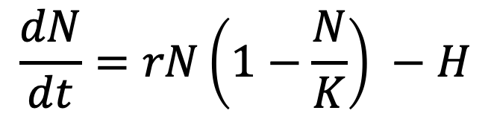
The case of the orange roughy highlights many of the inherent problems with MSY
r and K and N are difficult to measure.
Many harvesting models neglect population structure.
Simple harvesting models assume constant harvest.
MSY fails to acknowledge the reality of overfishing.
Because of the semi-stable equilibrium at MSY, small (natural) decreases in N can be devastating
environmental stochasticity
demographic stochasticity
$$\frac{dN}{dt}=rN\left(1−\frac{N}{K}\right) −H$$

Slide 47
The case of the orange roughy highlights many of the inherent problems with MSY
r and K and N are difficult to measure.
Many harvesting models neglect population structure.
Simple harvesting models assume constant harvest.
MSY fails to acknowledge the reality of overfishing.
Because of the semi-stable equilibrium at MSY, small (natural) decreases in N can be devastating
environmental stochasticity
demographic stochasticity
$$\frac{dN}{dt}=rN\left(1−\frac{N}{K}\right) −H$$

Slide 48
The case of the orange roughy highlights many of the inherent problems with MSY
r and K and N are difficult to measure.
Many harvesting models neglect population structure or model only a single species in isolation.
or model only a single species in isolation.
Simple harvesting models assume constant harvest.
MSY fails to acknowledge the reality of overfishing.
Because of the semi-stable equilibrium at MSY, small (natural) decreases in N can be devastating
environmental stochasticity
demographic stochasticity
$$\frac{dN}{dt}=rN\left(1−\frac{N}{K}\right) −H$$

Slide 49
The case of the orange roughy highlights many of the inherent problems with MSY
r and K and N are difficult to measure.
Many harvesting models neglect population structure or model only a single species in isolation.
Simple harvesting models assume constant harvest.
MSY fails to acknowledge the reality of overfishing.
Because of the semi-stable equilibrium at MSY, small (natural) decreases in N can be devastating
environmental stochasticity
demographic stochasticity
$$\frac{dN}{dt}=rN\left(1−\frac{N}{K}\right) −H$$

Slide 50
The case of the orange roughy highlights many of the inherent problems with MSY
r and K and N are difficult to measure.
Many harvesting models neglect population structure or model only a single species in isolation.
Simple harvesting models assume constant harvest.
MSY fails to acknowledge the reality of overfishing.
Because of the semi-stable equilibrium at MSY, small (natural) decreases in N can be devastating
environmental stochasticity
demographic stochasticity
$$\frac{dN}{dt}=rN\left(1−\frac{N}{K}\right) −H$$

Slide 51
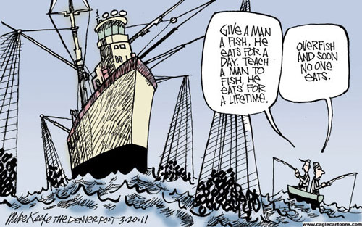
Overfishing: A Tragedy of the Commons
Tragedy of the Commons:
Individuals incentivized to use as much of a shared, open access resource as possible to maximize their own benefit.
The cost of depleting the resource (e.g., overgrazing the pasture, overfishing, polluting the air) is borne by the entire group, not just by the individual who is using it heavily.
Each individual's actions can negatively impact everyone.
Tragedy results: Too many fish are removed, the pasture is overgrazed
Idea was popularized by ecologist Garret Hardin in 1968, a Malthus-like reference to the overpopulation of the Earth
Fisheries provide a classic example of Tragedy of the Commons because property rights are incomplete and access is open. Many examples of fisheries collapse:
Sturgeon in Caspian sea in 2000s
Atlantic cod in Canada & elsewhere in 1990s
Orange roughy in NZ in 1990s
Despite its dangers, MSY is still highlight as a policy in many international treaties.
Notes:
Garret Hardin = Malthusian, anti-welfare philosophy
Contrast with Elinor Ostrom’s work on successful cooperation for managing land
Each individual has an incentive to use as much of the shared, open access resource as possible to maximize their own benefit. The cost of depleting the resource (e.g., overgrazing the pasture, overfishing, polluting the air) is borne by the entire group, not just by the individual who is using it heavily. Therefore, each individual's actions can negatively impact everyone else. Tragedy results: Too many fish are removed, the pasture is overgrazed, the concentration of pollutants
becomes very high. So everyone loses in the end.”

Slide 52
Overfishing: A Tragedy of the Commons
Tragedy of the Commons:
Individuals incentivized to use as much of a shared, open access resource as possible to maximize their own benefit.
The cost of depleting the resource (e.g., overgrazing the pasture, overfishing, polluting the air) is borne by the entire group, not just by the individual who is using it heavily.
Each individual's actions can negatively impact everyone.
Tragedy results: Too many fish are removed, the pasture is overgrazed
Idea was popularized by ecologist Garret Hardin in 1968, a Malthus-like reference to the overpopulation of the Earth
Fisheries provide a classic example of Tragedy of the Commons because property rights are incomplete and access is open. Many examples of fisheries collapse:
Sturgeon in Caspian sea in 2000s
Atlantic cod in Canada & elsewhere in 1990s
Orange roughy in NZ in 1990s
Despite its dangers, MSY is still highlight as a policy in many international treaties.
Notes:
Garret Hardin = Malthusian, anti-welfare philosophy
Contrast with Elinor Ostrom’s work on successful cooperation for managing land
Each individual has an incentive to use as much of the shared, open access resource as possible to maximize their own benefit. The cost of depleting the resource (e.g., overgrazing the pasture, overfishing, polluting the air) is borne by the entire group, not just by the individual who is using it heavily. Therefore, each individual's actions can negatively impact everyone else. Tragedy results: Too many fish are removed, the pasture is overgrazed, the concentration of pollutants
becomes very high. So everyone loses in the end.”

Slide 53
Overfishing: A Tragedy of the Commons
Tragedy of the Commons:
Individuals incentivized to use as much of a shared, open access resource as possible to maximize their own benefit.
The cost of depleting the resource (e.g., overgrazing the pasture, overfishing, polluting the air) is borne by the entire group, not just by the individual who is using it heavily.
Each individual's actions can negatively impact everyone.
Tragedy results: Too many fish are removed, the pasture is overgrazed
Idea was popularized by ecologist Garret Hardin in 1968, a Malthus-like reference to the overpopulation of the Earth
Fisheries provide a classic example of Tragedy of the Commons because property rights are incomplete and access is open. Many examples of fisheries collapse:
Sturgeon in Caspian sea in 2000s
Atlantic cod in Canada & elsewhere in 1990s
Orange roughy in NZ in 1990s
Despite its dangers, MSY is still highlight as a policy in many international treaties.
Notes:
Garret Hardin = Malthusian, anti-welfare philosophy
Contrast with Elinor Ostrom’s work on successful cooperation for managing land
Each individual has an incentive to use as much of the shared, open access resource as possible to maximize their own benefit. The cost of depleting the resource (e.g., overgrazing the pasture, overfishing, polluting the air) is borne by the entire group, not just by the individual who is using it heavily. Therefore, each individual's actions can negatively impact everyone else. Tragedy results: Too many fish are removed, the pasture is overgrazed, the concentration of pollutants
becomes very high. So everyone loses in the end.”

Slide 54
Overfishing: A Tragedy of the Commons
Tragedy of the Commons:
Individuals incentivized to use as much of a shared, open access resource as possible to maximize their own benefit.
The cost of depleting the resource (e.g., overgrazing the pasture, overfishing, polluting the air) is borne by the entire group, not just by the individual who is using it heavily.
Each individual's actions can negatively impact everyone.
Tragedy results: Too many fish are removed, the pasture is overgrazed
Idea was popularized by ecologist Garret Hardin in 1968, a Malthus-like reference to the overpopulation of the Earth
Fisheries provide a classic example of Tragedy of the Commons because property rights are incomplete and access is open. Many examples of fisheries collapse:
Sturgeon in Caspian sea in 2000s
Atlantic cod in Canada & elsewhere in 1990s
Orange roughy in NZ in 1990s
Despite its dangers, MSY is still highlight as a policy in many international treaties.
Notes:
Garret Hardin = Malthusian, anti-welfare philosophy
Contrast with Elinor Ostrom’s work on successful cooperation for managing land
Each individual has an incentive to use as much of the shared, open access resource as possible to maximize their own benefit. The cost of depleting the resource (e.g., overgrazing the pasture, overfishing, polluting the air) is borne by the entire group, not just by the individual who is using it heavily. Therefore, each individual's actions can negatively impact everyone else. Tragedy results: Too many fish are removed, the pasture is overgrazed, the concentration of pollutants
becomes very high. So everyone loses in the end.”

Slide 55
Overfishing: A Tragedy of the Commons
Tragedy of the Commons:
Individuals incentivized to use as much of a shared, open access resource as possible to maximize their own benefit.
The cost of depleting the resource (e.g., overgrazing the pasture, overfishing, polluting the air) is borne by the entire group, not just by the individual who is using it heavily.
Each individual's actions can negatively impact everyone.
Tragedy results: Too many fish are removed, the pasture is overgrazed
Idea was popularized by ecologist Garret Hardin in 1968, a Malthus-like reference to the overpopulation of the Earth
Fisheries provide a classic example of Tragedy of the Commons because property rights are incomplete and access is open. Many examples of fisheries collapse:
Sturgeon in Caspian sea in 2000s
Atlantic cod in Canada & elsewhere in 1990s
Orange roughy in NZ in 1990s
Despite its dangers, MSY is still highlight as a policy in many international treaties.
Notes:
Garret Hardin = Malthusian, anti-welfare philosophy
Contrast with Elinor Ostrom’s work on successful cooperation for managing land
Each individual has an incentive to use as much of the shared, open access resource as possible to maximize their own benefit. The cost of depleting the resource (e.g., overgrazing the pasture, overfishing, polluting the air) is borne by the entire group, not just by the individual who is using it heavily. Therefore, each individual's actions can negatively impact everyone else. Tragedy results: Too many fish are removed, the pasture is overgrazed, the concentration of pollutants
becomes very high. So everyone loses in the end.”

Slide 56
Overfishing: A Tragedy of the Commons
Tragedy of the Commons:
Individuals incentivized to use as much of a shared, open access resource as possible to maximize their own benefit.
The cost of depleting the resource (e.g., overgrazing the pasture, overfishing, polluting the air) is borne by the entire group, not just by the individual who is using it heavily.
Each individual's actions can negatively impact everyone.
Tragedy results: Too many fish are removed, the pasture is overgrazed
Idea was popularized by ecologist Garret Hardin in 1968, a Malthus-like reference to the overpopulation of the Earth
Fisheries provide a classic example of Tragedy of the Commons because property rights are incomplete and access is open. Many examples of fisheries collapse:
Sturgeon in Caspian sea in 2000s
Atlantic cod in Canada & elsewhere in 1990s
Orange roughy in NZ in 1990s
Despite its dangers, MSY is still highlight as a policy in many international treaties.
Notes:
Garret Hardin = Malthusian, anti-welfare philosophy
Contrast with Elinor Ostrom’s work on successful cooperation for managing land
Each individual has an incentive to use as much of the shared, open access resource as possible to maximize their own benefit. The cost of depleting the resource (e.g., overgrazing the pasture, overfishing, polluting the air) is borne by the entire group, not just by the individual who is using it heavily. Therefore, each individual's actions can negatively impact everyone else. Tragedy results: Too many fish are removed, the pasture is overgrazed, the concentration of pollutants
becomes very high. So everyone loses in the end.”

Slide 57
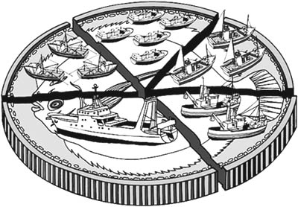
Managing the Commons - Internationally
Total Allowable Catch (TAC) = total number of fish allowed to be caught in each fishery each year
Government coordination attempt to set international management goals
Can lead to intense pressure to fish all at once at the season’s opening, sometimes overshooting the TAC.
Individual Fishing Quotas (IFQs) = allocation by country or individual fisher
Can mitigate TAC challenges
Individual Transferrable Quotas (ITQs) = can be traded or transferred
allocation is still a challenge
Notes:
These port-level networks vary in properties such as network resilience (colour of port-location dots: red is lower resilience, green is greater resilience), and they are also comprised of both state and federally managed fisheries (small networks on right: red and blue nodes, respectively).

Slide 58
Managing the Commons - Internationally
Total Allowable Catch (TAC) = total number of fish allowed to be caught in each fishery each year
Government coordination attempt to set international management goals
Can lead to intense pressure to fish all at once at the season’s opening, sometimes overshooting the TAC.
Individual Fishing Quotas (IFQs) = allocation by country or individual fisher
Can mitigate TAC challenges
Individual Transferrable Quotas (ITQs) = can be traded or transferred
allocation is still a challenge
Notes:
These port-level networks vary in properties such as network resilience (colour of port-location dots: red is lower resilience, green is greater resilience), and they are also comprised of both state and federally managed fisheries (small networks on right: red and blue nodes, respectively).

Slide 59
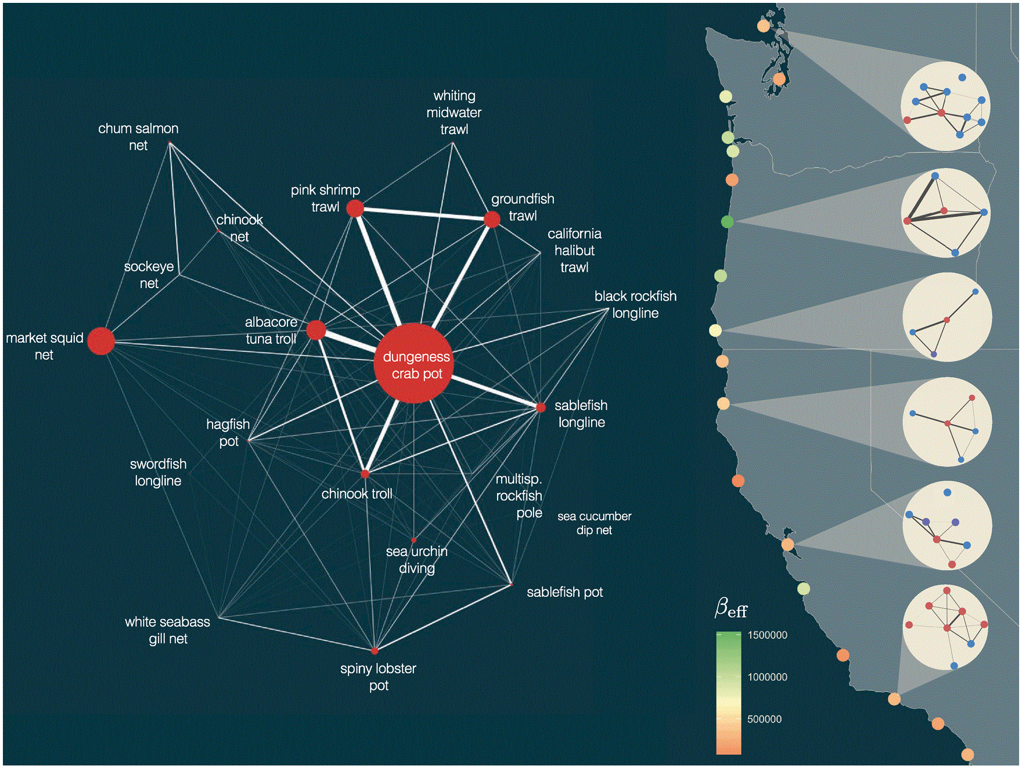
Managing the Commons - Locally
The work of Elinor Ostrom showed that some of these challenges can be overcome when:
resource limits are clearly defined
the group of stakeholders is small
communication is high
Dr. Emma Fuller, Fractal Agriculture
Fuller et al. 2017. ICES Journal of Marine Science
Notes:
These port-level networks vary in properties such as network resilience (colour of port-location dots: red is lower resilience, green is greater resilience), and they are also comprised of both state and federally managed fisheries (small networks on right: red and blue nodes, respectively).

Slide 60
The case of the orange roughy highlights many of the inherent problems with MSY
r and K and N are difficult to measure.
Many harvesting models neglect population structure or model only a single species in isolation.
Simple harvesting models assume constant harvest.
MSY fails to acknowledge the reality of overfishing.
Because of the semi-stable equilibrium at MSY, small (natural) decreases in N can be devastating
environmental stochasticity
demographic stochasticity
$$\frac{dN}{dt}=rN\left(1−\frac{N}{K}\right) −H$$

Slide 61
Deterministic vs. Stochastic

Slide 62

Deterministic vs. Stochastic
if deterministic
“always the same”
annual survival rate = 0.5

Slide 63
Deterministic vs. Stochastic
if deterministic
“always the same”
annual survival rate = 0.5

Slide 64
Deterministic vs. Stochastic
if deterministic
“always the same”
annual survival rate = 0.5
All the models we have looked at so far have been deterministic!

Slide 65
Deterministic vs. Stochastic
if deterministic
“always the same”
annual survival rate = 0.5
if stochastic
“up to chance”
annual survival rate = 0.5

Slide 66
Deterministic vs. Stochastic
if deterministic
“always the same”
annual survival rate = 0.5
if stochastic
“up to chance”
annual survival rate = 0.5

Slide 67
Deterministic vs. Stochastic
if deterministic
“always the same”
annual survival rate = 0.5
if stochastic
“up to chance”
annual survival rate = 0.5

Slide 68
The case of the orange roughy highlights many of the inherent problems with MSY
r and K and N = difficult to measure.
Neglect population structure.
Single species models.
Assumes constant harvest.
Ignores reality of overfishing.
Because of the semi-stable equilibrium at MSY, small (natural) decreases in N can be devastating
environmental stochasticity
temporal changes in mortality or reproductive rate (e.g. due to climate)
if stochastic
“up to chance”
annual survival rate = 0.5
cyclone year!
Notes:
Demographic stochasticity describes the within-individual variability (growth rate might vary from one individual to the next)
while environmental stochasticity refers to temporary environmental fluctuations that lead to changes in population growth rates (climate change and egg survival)

Slide 69
The case of the orange roughy highlights many of the inherent problems with MSY
r and K and N = difficult to measure.
Neglect population structure.
Single species models.
Assumes constant harvest.
Ignores reality of overfishing.
Because of the semi-stable equilibrium at MSY, small (natural) decreases in N can be devastating
environmental stochasticity
temporal changes in mortality or reproductive rate (due to climate)
demographic stochasticity
individual-level differences in mortality and reproduction, esp. at small pop size
if deterministic
“always the same”
annual fecundity = 0.5
Notes:
Demographic stochasticity describes the within-individual variability (growth rate might vary from one individual to the next)
while environmental stochasticity refers to temporary environmental fluctuations that lead to changes in population growth rates (climate change and egg survival)

Slide 70


The case of the orange roughy highlights many of the inherent problems with MSY
r and K and N = difficult to measure.
Neglect population structure.
Single species models.
Assumes constant harvest.
Ignores reality of overfishing.
Because of the semi-stable equilibrium at MSY, small (natural) decreases in N can be devastating
environmental stochasticity
temporal changes in mortality or reproductive rate (due to climate)
demographic stochasticity
individual-level differences in mortality and reproduction, esp. at small pop size
if stochastic
“up to chance”
annual fecundity = 0.5
Only one male encounters only one female, so only 1 new fish is born!
Notes:
Demographic stochasticity describes the within-individual variability (growth rate might vary from one individual to the next)
while environmental stochasticity refers to temporary environmental fluctuations that lead to changes in population growth rates (climate change and egg survival)

Slide 71


Slide 72
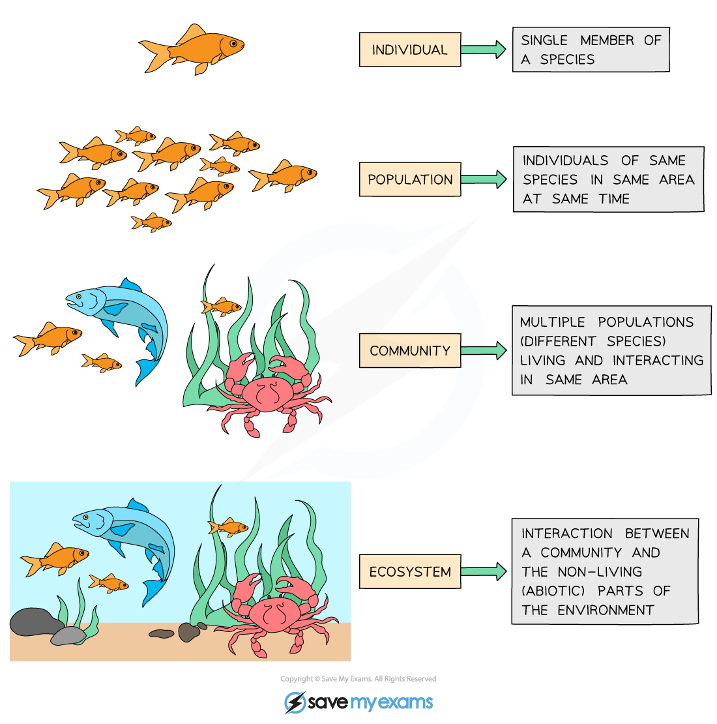
Ecology is the study of the interactions of organisms with each other and their environment.
individual
population
metapopulation
community
ecosystem
Notes:
We explore ecology – using models – across scales

Slide 73
individual
Population = multiple individuals of the same species (conspecifics) in the same habitat
population
metapopulation
fish
(x)
community
How does the abundance of fish change through time?
ecosystem

Slide 74
Lecture ended here – Jan 2025

Slide 75
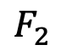
individual
Structured Population = multiple individuals of the same species (conspecifics) in the same habitat but in different life history stages
population
metapopulation
$$F_{2}$$
baby fish (x₁)
adult fish (x₂)
community
1
2
How does the abundance of fish change through time?
ecosystem

Slide 76
Modeling demographic complexity

Slide 77
Modeling demographic complexity
1. Populations are divided into compartments
2. Individuals within a compartment are homogenously mixed
3. Compartments and transition rates are
determined by biological systems
4. Rates of transferring between compartments
are expressed mathematically
births
Madagascar
(N)
deaths
The simplest
population model

Slide 78
Modeling demographic complexity
1. Populations are divided into compartments
2. Individuals within a compartment are homogenously mixed
3. Compartments and transition rates are
determined by biological systems
4. Rates of transferring between compartments
are expressed mathematically
births
Madagascar
(N)
deaths
What is wrong about this model?

Slide 79
Modeling demographic complexity
1. Populations are divided into compartments
2. Individuals within a compartment are homogenously mixed
3. Compartments and transition rates are
determined by biological systems
4. Rates of transferring between compartments
are expressed mathematically
births
Madagascar
(N)
deaths
What is wrong about this model?

Slide 80
Modeling demographic complexity
1. Populations are divided into compartments
2. Individuals within a compartment are homogenously mixed
3. Compartments and transition rates are
determined by biological systems
4. Rates of transferring between compartments
are expressed mathematically
Babies
Adults
The structured
population model

Slide 81
Modeling demographic complexity
1. Populations are divided into compartments
2. Individuals within a compartment are homogenously mixed
3. Compartments and transition rates are
determined by biological systems
4. Rates of transferring between compartments
are expressed mathematically
Babies
Adults
The structured
population model

Slide 82
Modeling demographic complexity
1. Populations are divided into compartments
2. Individuals within a compartment are homogenously mixed
3. Compartments and transition rates are
determined by biological systems
4. Rates of transferring between compartments
are expressed mathematically
births
Babies
aging
Adults
deaths
deaths
The structured
population model

Slide 83
The structured
population model
1. Populations are divided into compartments
2. Individuals within a compartment are homogenously mixed
3. Compartments and transition rates are
determined by biological systems
4. Rates of transferring between compartments
are expressed mathematically
Births (B)
Population rate of increase
Babies
aging (a)
Adults
λ=N_{t+1}/N_{t}
deaths (1-s_{b})
deaths (1-s_{a})
N_{t+1} = A* N_{t}
pop size at t
pop size at t + 1
matrix of survival and fecundity rates
vector of
population sizes
s_{b}(1-a)
B
s_{b}a
s_{a}

Slide 84
The structured
population model
1. Populations are divided into compartments
2. Individuals within a compartment are homogenously mixed
3. Compartments and transition rates are
determined by biological systems
4. Rates of transferring between compartments
are expressed mathematically
Births (B)
Population rate of increase
Babies
aging (a)
Adults
λ=N_{t+1}/N_{t}
deaths (1-s_{b})
deaths (1-s_{a})
N_{t+1} = A* N_{t}
pop size at t
pop size at t + 1
matrix of survival and fecundity rates
vector of
population sizes
s_{b}(1-a)
B
s_{b}a
s_{a}
*Discrete time

Slide 85
The structured
population model
1. Populations are divided into compartments
2. Individuals within a compartment are homogenously mixed
3. Compartments and transition rates are
determined by biological systems
4. Rates of transferring between compartments
are expressed mathematically
Births (B)
Babies
aging (a)
Adults
deaths (1-s_{b})
deaths (1-s_{a})
N_{t+1} = A* N_{t}
A
N_{t}
N_{t+1}
s_{b}(1-a)
B
N_{b}
s_{b}(1-a) N_{b} + BN_{a}
x
=
s_{b}a
s_{a}
N_{a}
s_{b} a N_{b} + s_{a}N_{a}

Slide 86
The structured
population model
1. Populations are divided into compartments
2. Individuals within a compartment are homogenously mixed
3. Compartments and transition rates are
determined by biological systems
4. Rates of transferring between compartments
are expressed mathematically
Births (B)
Babies
aging (a)
Adults
deaths (1-s_{b})
deaths (1-s_{a})
N_{t+1} = A* N_{t}
A
N_{t}
N_{t+1}
Population rate of increase – can be derived from the transition matrix!
s_{b}(1-a)
B
N_{b}
s_{b}(1-a) N_{b} + BN_{a}
x
=
λ
s_{b}a
s_{a}
N_{a}
s_{b} a N_{b} + s_{a}N_{a}
Population growth will depend on population structure!
(pop grows @ λ >1 & declines @ λ < 1 )
Notes:
Lambda is the dominant eigenvalue of the transition matrix

Slide 87
Structured populations in practice
Soay Sheep of St. Kilda, Scotland
Notes:
Since the 1980s, scientists from Cambridge have been censusing them annually and tagging every individual. They exhibit these dramatic population fluctuations

Slide 88
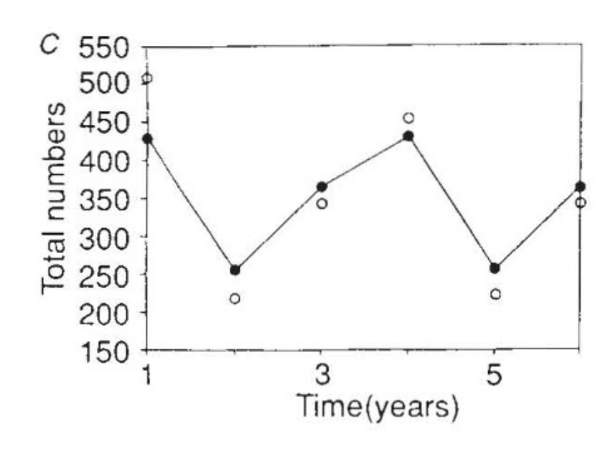
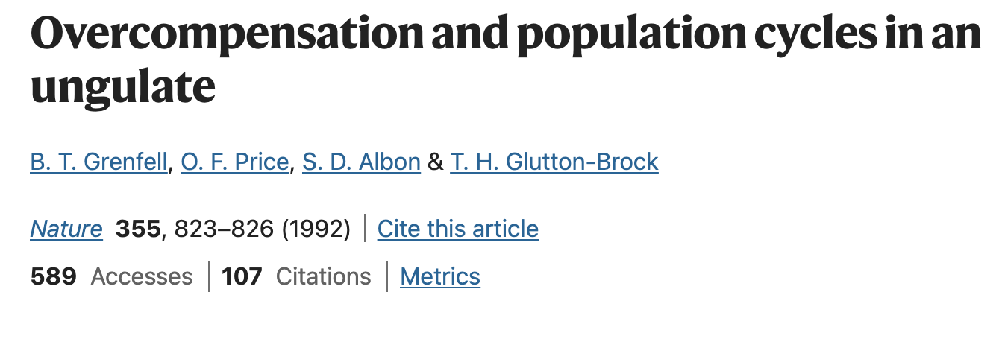
Structured populations in practice
Model compared against data
Soay Sheep of St. Kilda, Scotland
Notes:
Models used both to predict and to explain

Slide 89
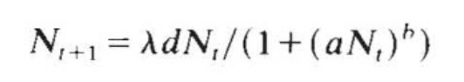
Structured populations in practice
Model compared against data
These results used a simple density-dependent model only!
a and b control the strength of density dependence.
growth rate
population at t+1
average fecundity
population at t
Notes:
Models used both to predict and to explain

Slide 90
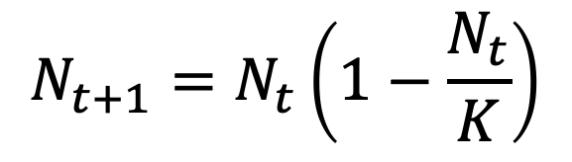
Structured populations in practice
Model compared against data
These results used a simple density-dependent model only!
a and b control the strength of density dependence.
growth rate
population at t+1
average fecundity
population at t
Similar to the simple logistic growth equation!
$$N_{t+1}=N_{t}\left(1−\frac{N_{t}}{K}\right)$$
Notes:
Models used both to predict and to explain

Slide 91
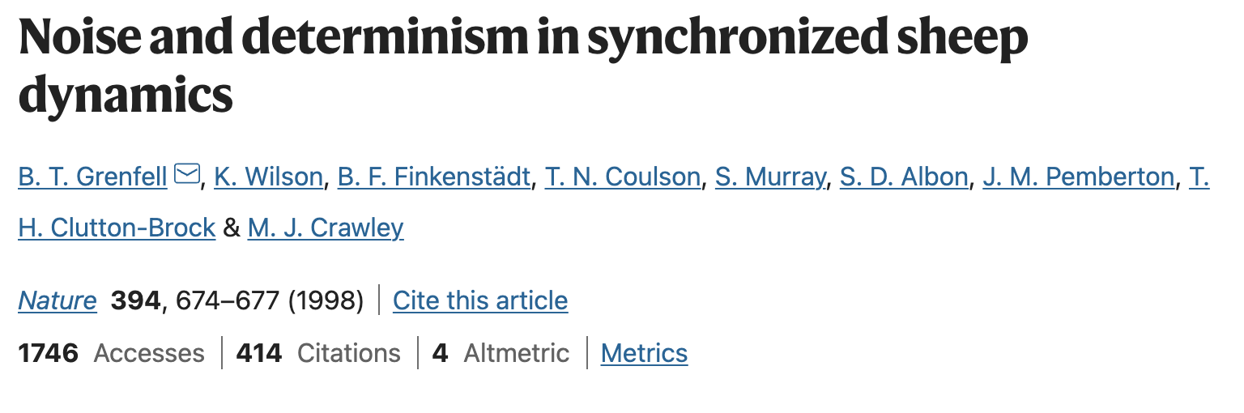
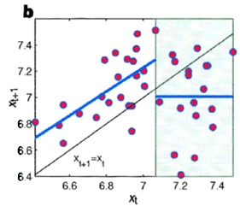
Structured populations in practice
In later work, the authors added environmental stochasticity (bad weather) to better represent the data……
Notes:
Models used both to predict and to explain

Slide 92
Structured populations in practice
In later work, the authors added environmental stochasticity (bad weather) to better represent the data……
At high population sizes, population crashes can occur due to density dependence – but these happen preferentially in bad weather!
sheep population at time t+1
sheep population at time t
Notes:
Models used both to predict and to explain

Slide 93
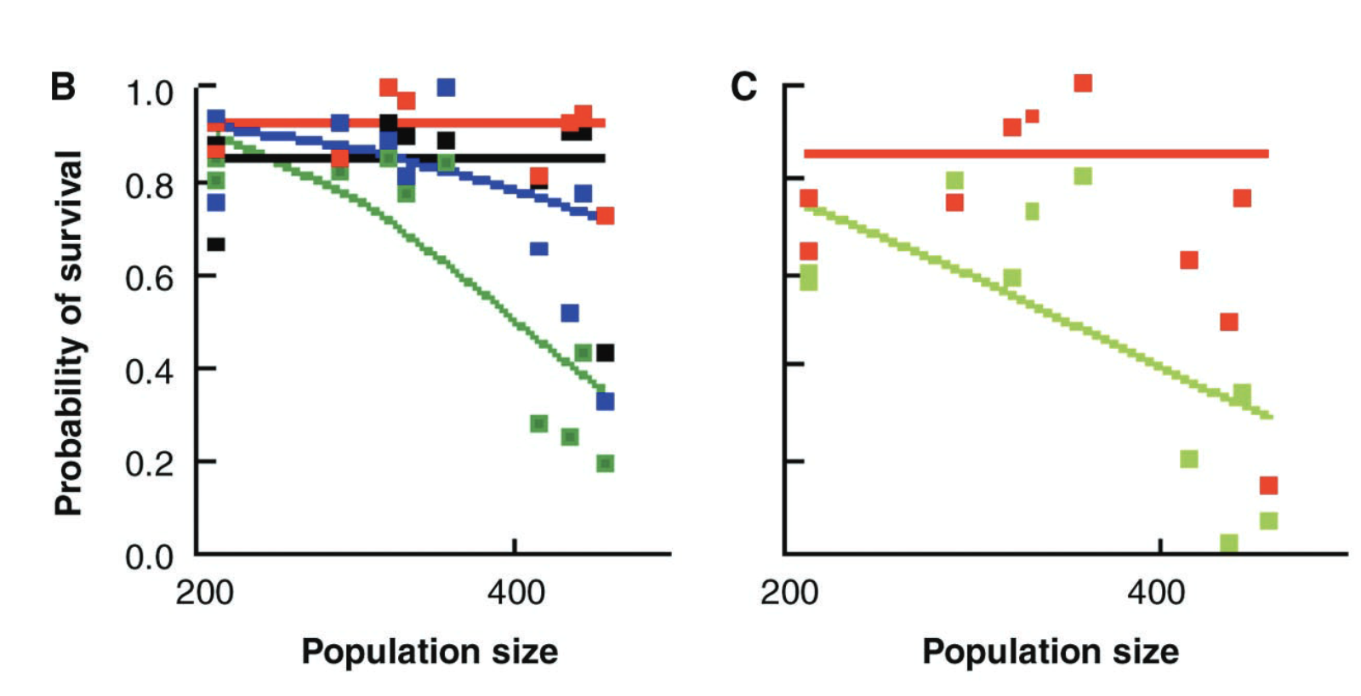
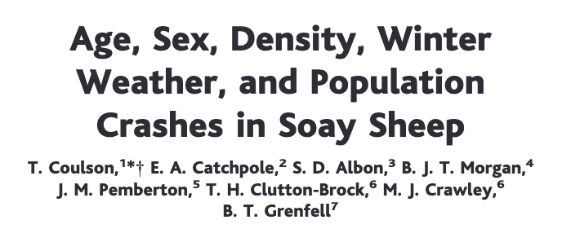

Structured populations in practice
And, finally, they added in population structure as well!
lambs
yearlings
adults
older adults
lambs
adults
Notes:
Colors

Slide 94
The structured
population model
If data are available, we can model much more detailed population structures using the same approach.
F₃
F₄
F₅
F₂
Age₁
Age₂
Age₃
Age₄
Age₅
s₁
s₂
s₃
s₄
The Leslie matrix model divides classes based on age.
The Lefkovitch matrix model divides classes based on life stage.
Leslie 1945 Biometrika. Leslie 1948 Biometrika.
Lefkovitch 1965 Biometrics.

Slide 95
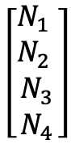
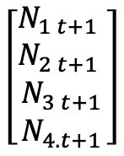
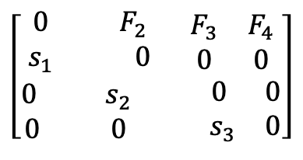
The structured
population model
If data are available, we can model much more detailed population structures using the same approach.
F₃
F₄
F₂
Age₁
Age₂
Age₃
Age₄
s₁
s₂
s₃
A
N_{t}
N_{t+1}
λ=can be derived from transition matrix
$$\left[\begin{aligned}\begin{matrix}0 & F_{2} \\ s_{1} & 0\end{matrix} \begin{matrix}F_{3} & F_{4} \\ 0 & 0\end{matrix} \\ \begin{matrix}0 & s_{2} \\ 0 & 0\end{matrix} \begin{matrix} 0 & 0 \\ .{ s}_{3} & 0\end{matrix}\end{aligned}\right]$$
$$\left[\begin{matrix}\begin{matrix}N_{1} \\ N_{2}\end{matrix} \\ \begin{matrix}N_{3} \\ N_{4}\end{matrix}\end{matrix}\right]$$
$$\left[\begin{matrix}\begin{matrix}N_{1 t+1} \\ N_{2 t+1}\end{matrix} \\ \begin{matrix}N_{3 t+1} \\ N_{4.t+1}\end{matrix}\end{matrix}\right]$$
x
=
N_{t+1} = A* N_{t}
Leslie 1945 Biometrika. Leslie 1948 Biometrika.
Lefkovitch 1965 Biometrics.

Slide 96
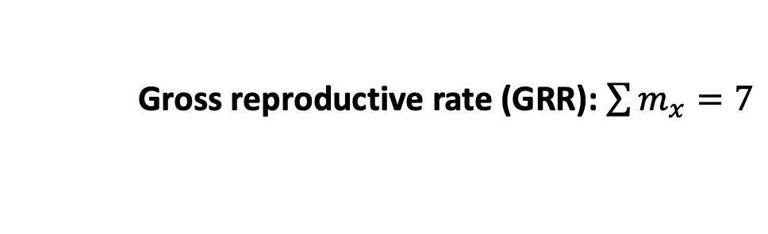
The structured
population model
F₃
F₄
F₂
Age₁
Age₂
Age₃
Age₄
Demographers collect these rates in life tables
s₁
s₂
s₃
x (age) | N_{x} (number in cohort) | l_{x} (survivorship to age x) | m_{x} (fecundity) | l_{x}m_{x}
0 | 100 | 1 | 0 | 0
1 | 60 | .6 | 2 | 1.2
2 | 30 | .3 | 3 | 0.9
3 | 10 | .1 | 1 | 0.1
4 | 1 | .01 | 1 | 0.01
x
=
Gross reproductive rate (GRR): $\sum{m_{x}=7}$

Slide 97
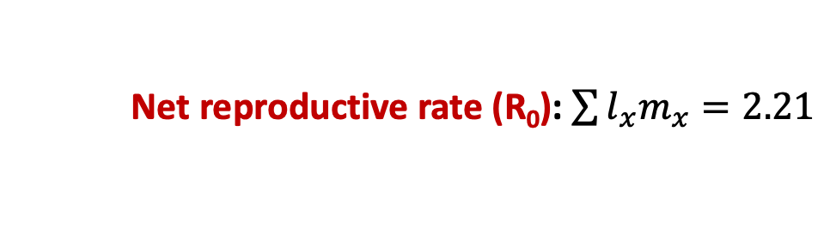
The structured
population model
F₃
F₄
F₂
Age₁
Age₂
Age₃
Age₄
Demographers collect these rates in life tables
s₁
s₂
s₃
x (age) | N_{x} (number in cohort) | l_{x} (survivorship to age x) | m_{x} (fecundity) | l_{x}m_{x}
0 | 100 | 1 | 0 | 0
1 | 60 | .6 | 2 | 1.2
2 | 30 | .3 | 3 | 0.9
3 | 10 | .1 | 1 | 0.1
4 | 1 | .01 | 1 | 0.01
x
=
Net reproductive rate (R₀): $\sum{l_{x}m_{x}=2.21}$

Slide 98
The structured
population model
F₃
F₄
F₂
Age₁
Age₂
Age₃
Age₄
Demographers collect these rates in life tables
s₁
s₂
s₃
x (age) | N_{x} (number in cohort) | l_{x} (survivorship to age x) | m_{x} (fecundity) | l_{x}m_{x}
0 | 100 | 1 | 0 | 0
1 | 60 | .6 | 2 | 1.2
2 | 30 | .3 | 3 | 0.9
3 | 10 | .1 | 1 | 0.1
4 | 1 | .01 | 1 | 0.01
x
=
Net reproductive rate (R₀): $\sum{l_{x}m_{x}=2.21}$
(pop grows at $R0$ >1 and declines at $R0$ < 1)

Slide 99
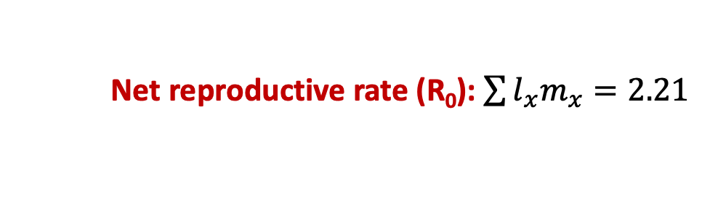
The structured
population model
F₃
F₄
F₂
Age₁
Age₂
Age₃
Age₄
Demographers collect these rates in life tables
s₁
s₂
s₃
x (age) | N_{x} (number in cohort) | l_{x} (survivorship to age x) | m_{x} (fecundity) | l_{x}m_{x}
0 | 100 | 1 | 0 | 0
1 | 60 | .6 | 2 | 1.2
2 | 30 | .3 | 3 | 0.9
3 | 10 | .1 | 1 | 0.1
4 | 1 | .01 | 1 | 0.01
x
=
Net reproductive rate (R₀): $\sum{l_{x}m_{x}=2.21}$
λ = ${R0}^{1/G}$ where G = length of a generation (often 1 year)

Slide 100
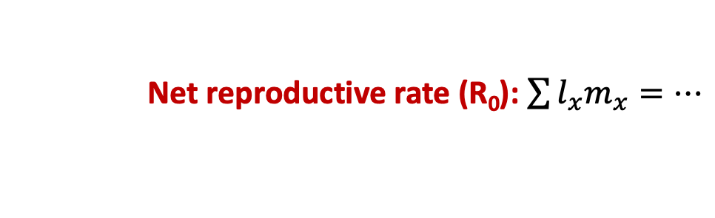
The structured
population model
F₃
F₄
F₂
Age₁
Age₂
Age₃
Age₄
s₁
s₂
s₃
x (age) | N_{x} (number in cohort) | l_{x} (survivorship to age x) | m_{x} (fecundity) | l_{x}m_{x}
0 | 100 | 1 | 0 | 0
1 | 60 | .6 | 2 | 1.2
2 | 30 | .3 | 3 | 0.9
3 | 10 | .1 | 1 | 0.1
4 | 1 | .01 | 1 | 0.01
x
=
…
Orange roughy can live up to 200 years!
Net reproductive rate (R₀): $\sum{l_{x}m_{x}=…}$

Slide 101
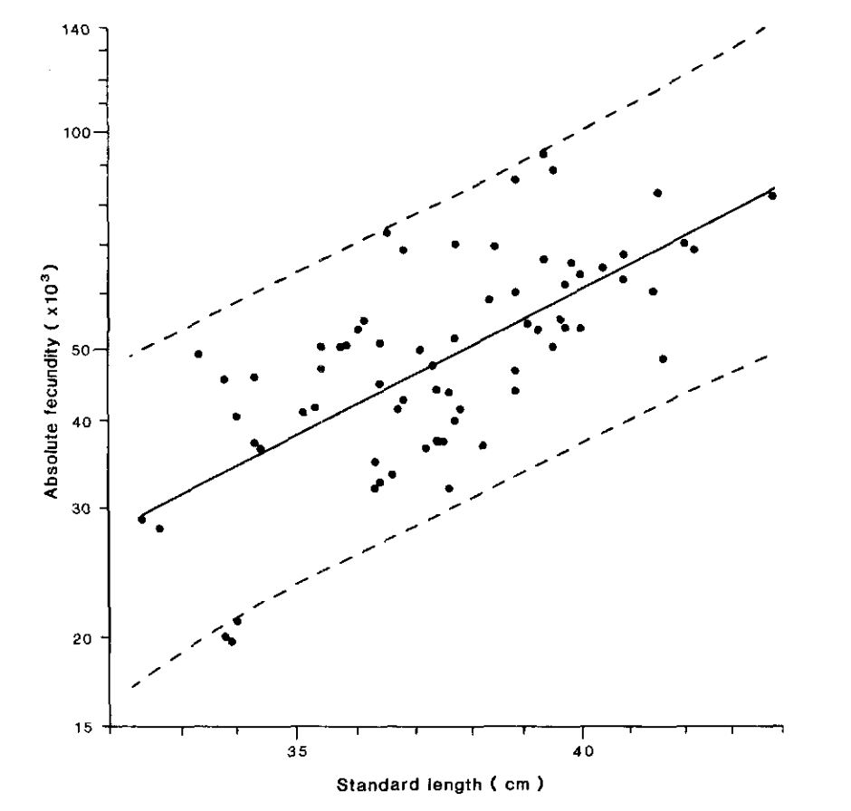

The structured
population model
F₃
F₄
F₂
Age₁
Age₂
Age₃
Age₄
s₁
s₂
s₃
Fecundity (eggs) increases in older, bigger fish!
Absolute fecundity (x10³)
Pankhurst & Conroy 1987
NZ J of Marine & Freshwater Res
Standard length (cm)
Net reproductive rate (R₀): $\sum{l_{x}m_{x}=…}$

Slide 102
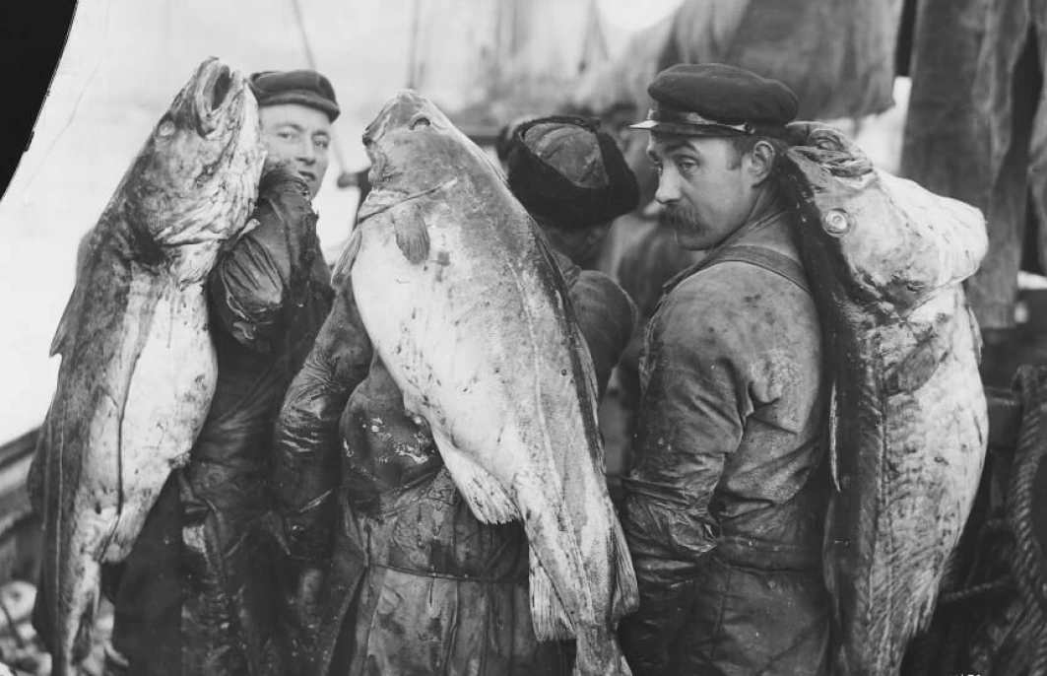
The structured
population model
F₃
F₄
F₂
Age₁
Age₂
Age₃
Age₄
s₁
s₂
s₃
Fecundity (eggs) increases in older, bigger fish!
Absolute fecundity (x10³)
These are precisely the fish we like to catch! One of the problems with MSY…
Norway 1910
(Norsk folkemuseum)
Standard length (cm)

Slide 103
The structured
population model
F₃
F₄
F₂
Age₁
Age₂
Age₃
Age₄
s₁
s₂
s₃
Poor modeling projections has led to severe overexploitation, a common problem in fisheries…
In 2008, the international TAC for orange roughy was reduced from 1470 tons to 914 tons… down from over 90,000 tons in the early 1990s…

Slide 104

The structured
population model
F₃
F₄
F₂
Age₁
Age₂
Age₃
Age₄
Life table analysis is also used extensively in human demography.
s₁
s₂
s₃
Edmond Halley, 1693
“An estimate of the degrees of the mortality of mankind, drawn from curious tables of the births and funerals at the city of Breslau, with an attempt to ascertain the price of annuities upon lives…”
Notes:
Halley= English astronomer, mathematician, and physicist

Slide 105

The structured
population model
F₃
F₄
F₂
Age₁
Age₂
Age₃
Age₄
Population pyramid for Breslau
s₁
s₂
s₃
Edmond Halley, 1693
“An estimate of the degrees of the mortality of mankind, drawn from curious tables of the births and funerals at the city of Breslau, with an attempt to ascertain the price of annuities upon lives…”
Notes:
Halley

Slide 106



The structured
population model
F₃
F₄
F₂
Age₁
Age₂
Age₃
Age₄
Population pyramid for Breslau
s₁
s₂
s₃
Humans are not like fish!
Fecundity tends to decrease in older age classes due to reproductive senescence.
Younger human populations that start giving birth earlier grow faster!
A
N_{t}
N_{t+1}
$$\left[\begin{aligned}\begin{matrix}0 & F_{2} \\ s_{1} & 0\end{matrix} \begin{matrix}F_{3} & F_{4} \\ 0 & 0\end{matrix} \\ \begin{matrix}0 & s_{2} \\ 0 & 0\end{matrix} \begin{matrix} 0 & 0 \\ .{ s}_{3} & 0\end{matrix}\end{aligned}\right]$$
$$\left[\begin{matrix}\begin{matrix}N_{1} \\ N_{2}\end{matrix} \\ \begin{matrix}N_{3} \\ N_{4}\end{matrix}\end{matrix}\right]$$
$$\left[\begin{matrix}\begin{matrix}N_{1 t+1} \\ N_{2 t+1}\end{matrix} \\ \begin{matrix}N_{3 t+1} \\ N_{4.t+1}\end{matrix}\end{matrix}\right]$$
x
=
Notes:
Halley

Slide 107


Slide 108

Demographic transition
Notes:
5 stages to a demographic transition – high pop growth in stage 2

Slide 109
Demographic transition
Notes:
5 stages to a demographic transition – high pop growth in stage 2

Slide 110

Demographic transition
Death rates are falling globally…

Slide 111

Demographic transition
And birth rates are also falling…

Slide 112

Demographic transition
Notes:
5 stages to a demographic transition – high pop growth in stage 2

Slide 113
Demographic transition
How does age structure predict population growth?
Notes:
5 stages to a demographic transition – high pop growth in stage 2

Slide 114

Demographic transition
How does age structure predict population growth?
Notes:
5 stages to a demographic transition – high pop growth in stage 2

Slide 115


Where are we globally?
Notes:
5 stages to a demographic transition – high pop growth in stage 2

Slide 116


Where are we globally?
Notes:
Declining death rates without declining birth rates

Slide 117

Where are we globally?

Slide 118


